Slide 1


ABI Summer 2021 Introduction to Statistics
Guest Session 1
Javier Cabrera*, Volha Tryputsen** & Davit Sargsyan**
June 29, 2021
(*)Rutgers, the State University of New Jersey
(**)Janssen Pharmaceutical Research and Development (J&J)

Slide 2
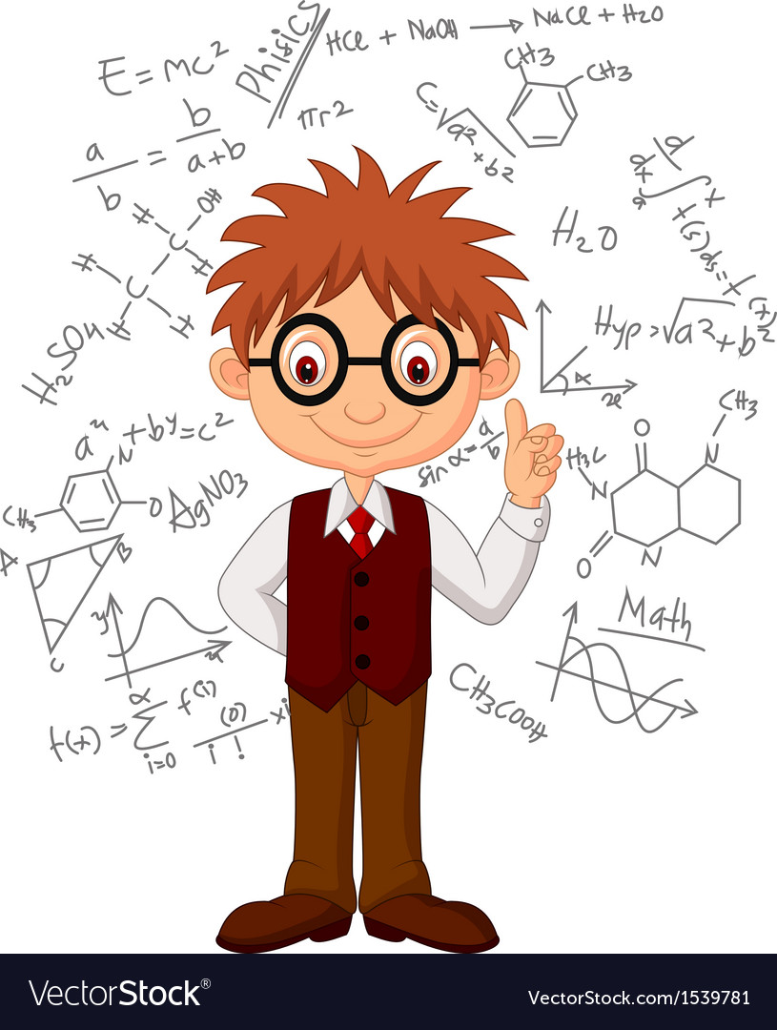
Why and How I Became a Statistician
When I grow up, I will be a statistician and my work will make the World a better place!
Notes:
Who doesn’t’ like the stories about people achieving their childhood dreams?

Slide 3
Why and How I Became a Statistician
When I grow up, I will be a statistician and my work will make the World a better place!
Notes:
Unfortunately, this is not one of these stories.

Slide 4


Why and How I Became a Statistician
Declare your major right now!
I love math…?
Notes:
In 1997, when I was 16, I applied to what is now the Armenian University of Economics.

Slide 5
Why and How I Became a Statistician
Statistics it is!
Notes:
This was the first time I hear the word “statistics”.

Slide 6
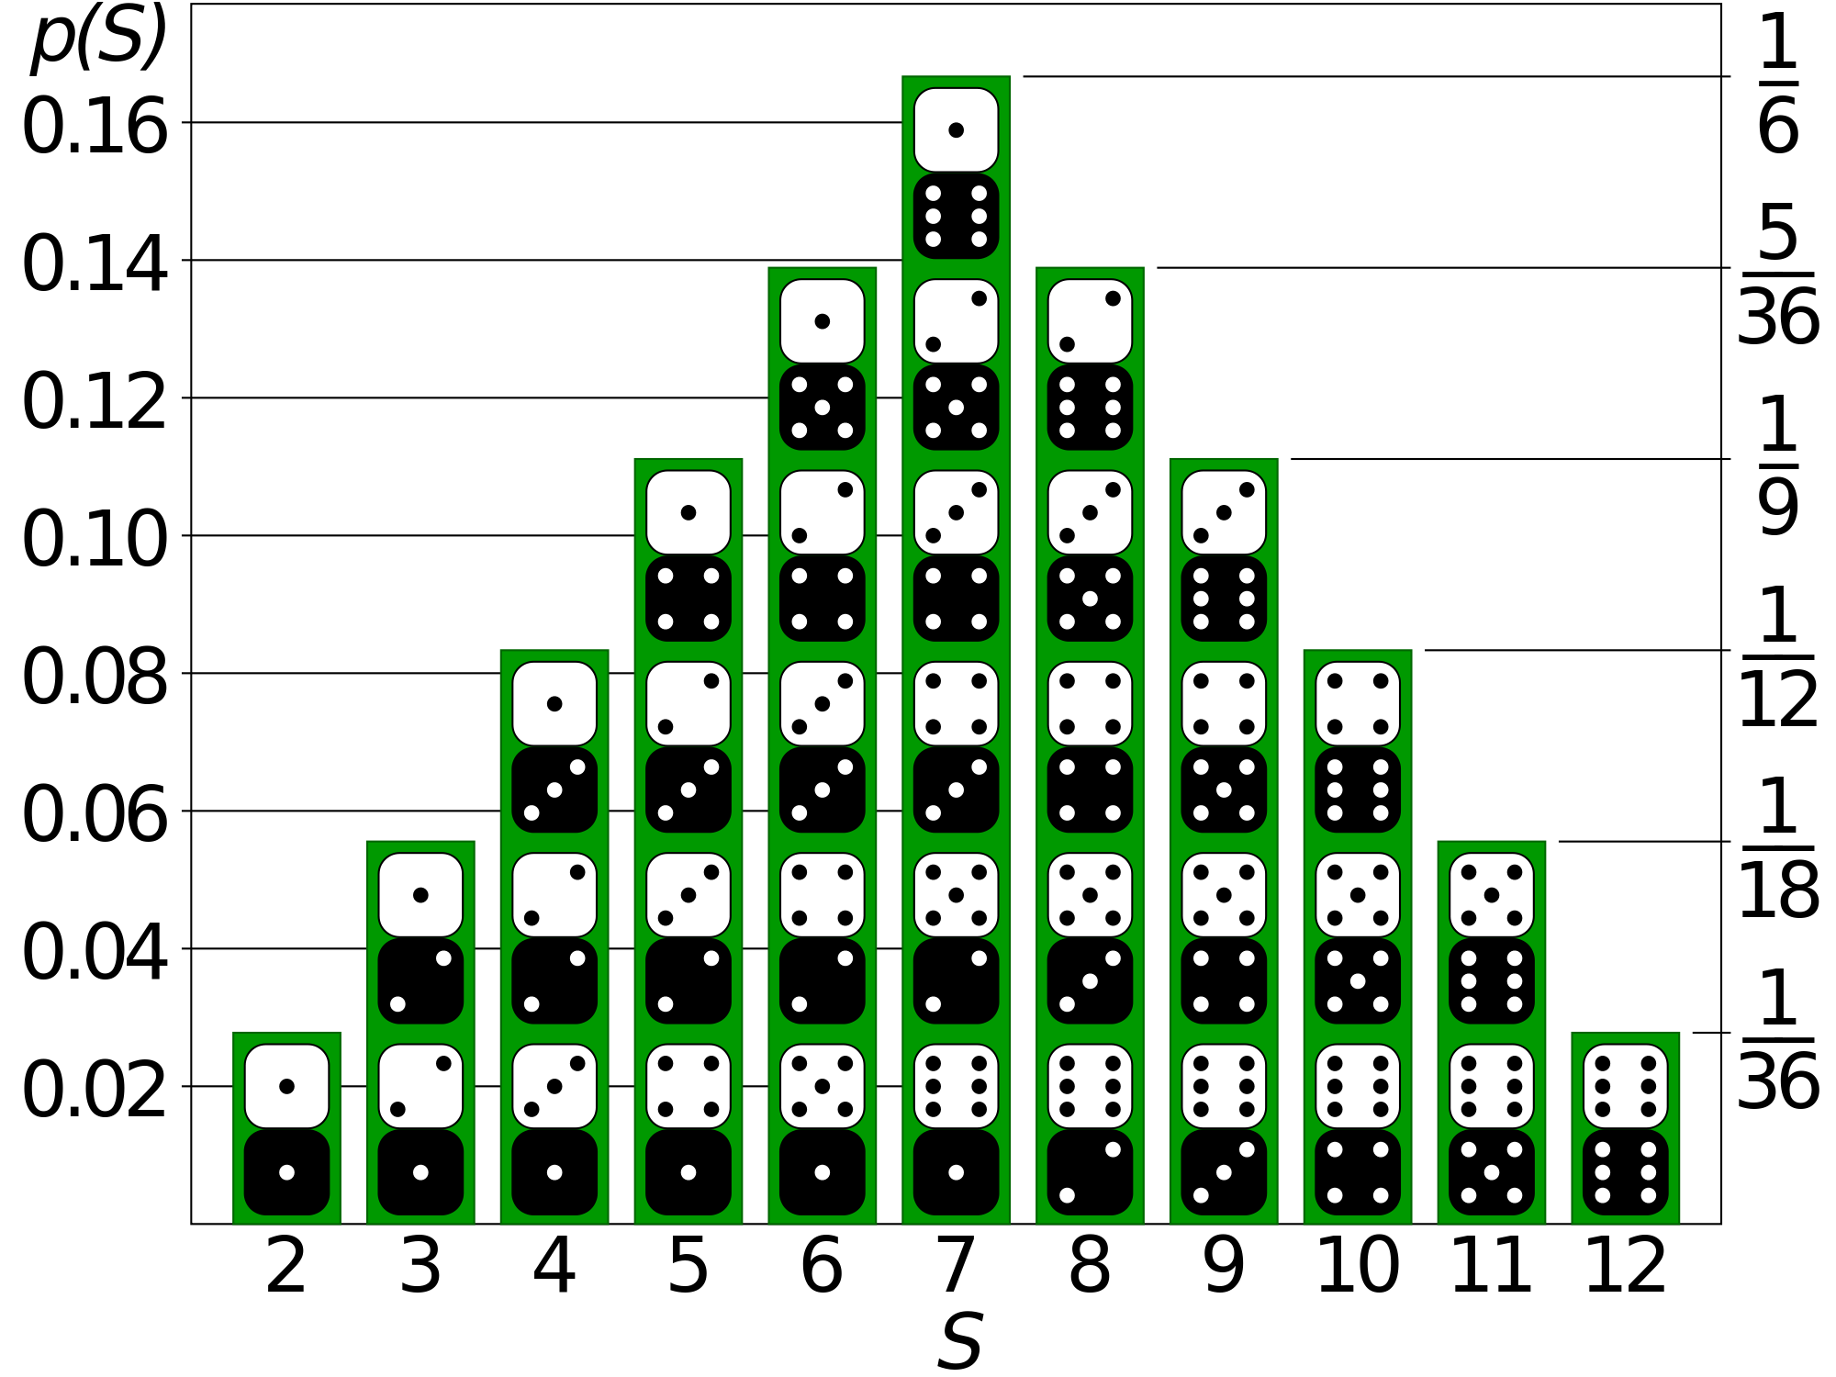
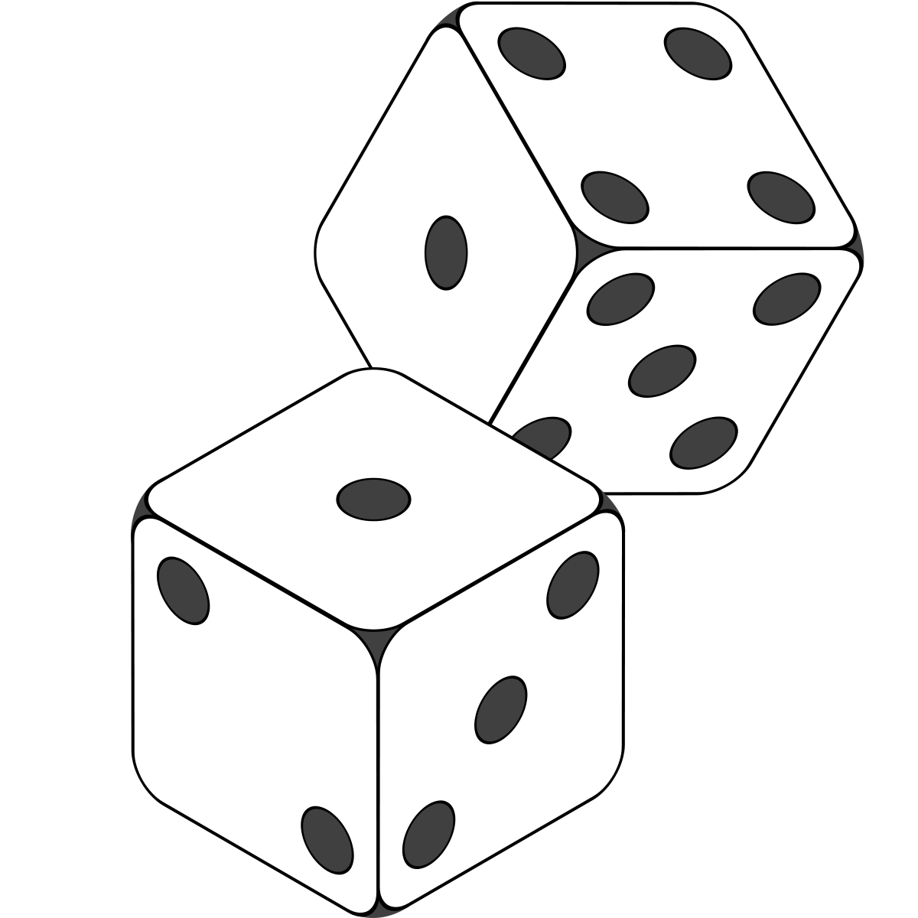
Probability and Distributions
Notes:
Let’s use this example to think about probabilities and distributions.

Slide 7
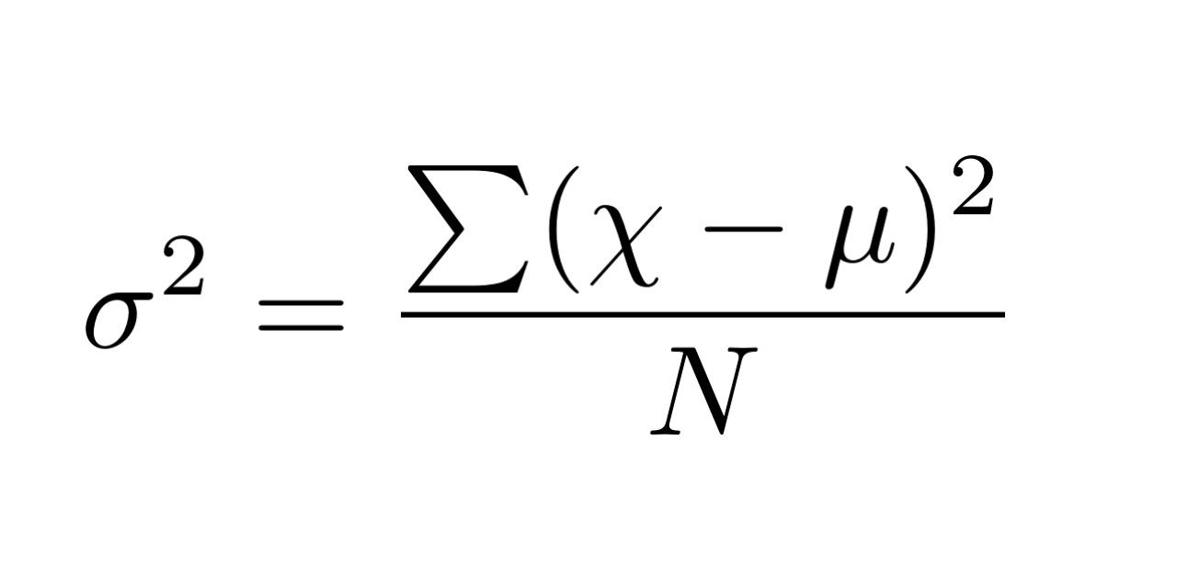
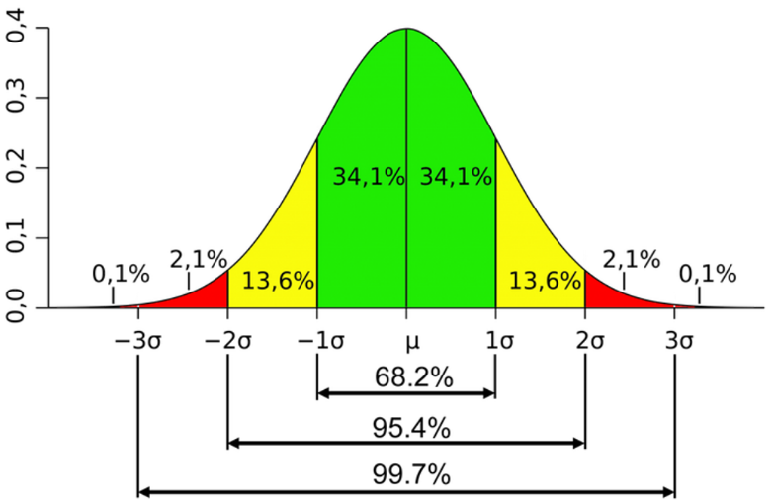
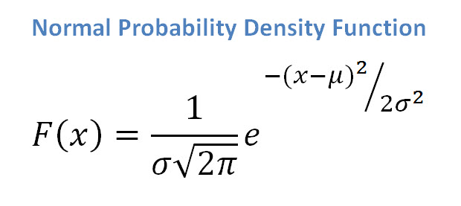
Normal Distribution

Slide 8
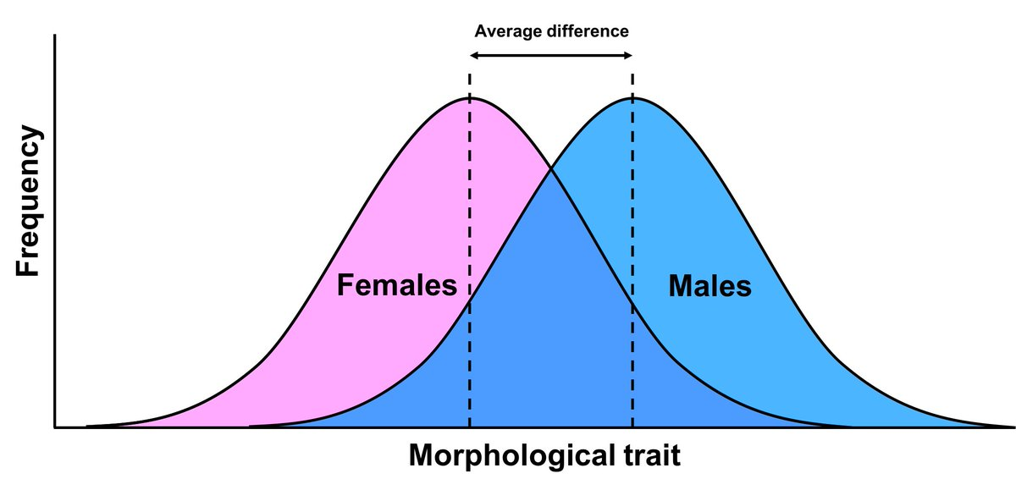
Probability and Distributions
Notes:
The outcomes do not need to be discrete (as in dice). When dealing with continuous measurements, probability of any specific value in a large population is close to 0 but we can define a probability of the observation to be in a specific range.

Slide 9
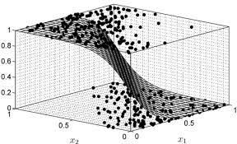

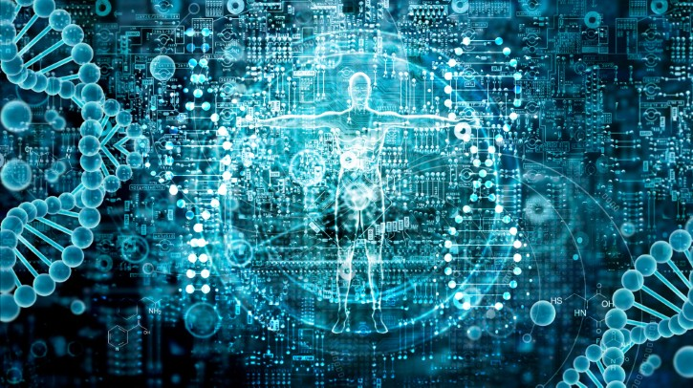
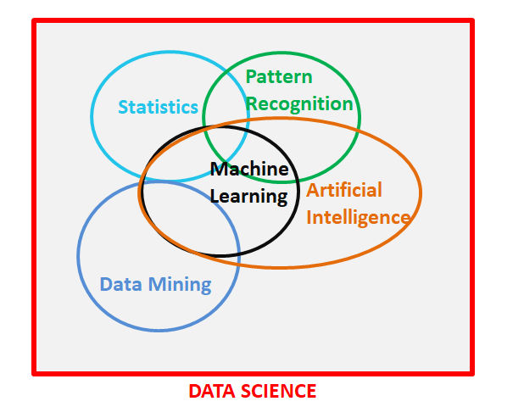
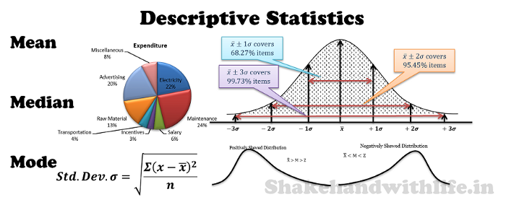
Applications of Statistics
Notes:
While studying at Rutgers, I finally began to understand the power of statistics and its wide applications in solving real world problems.

Slide 10
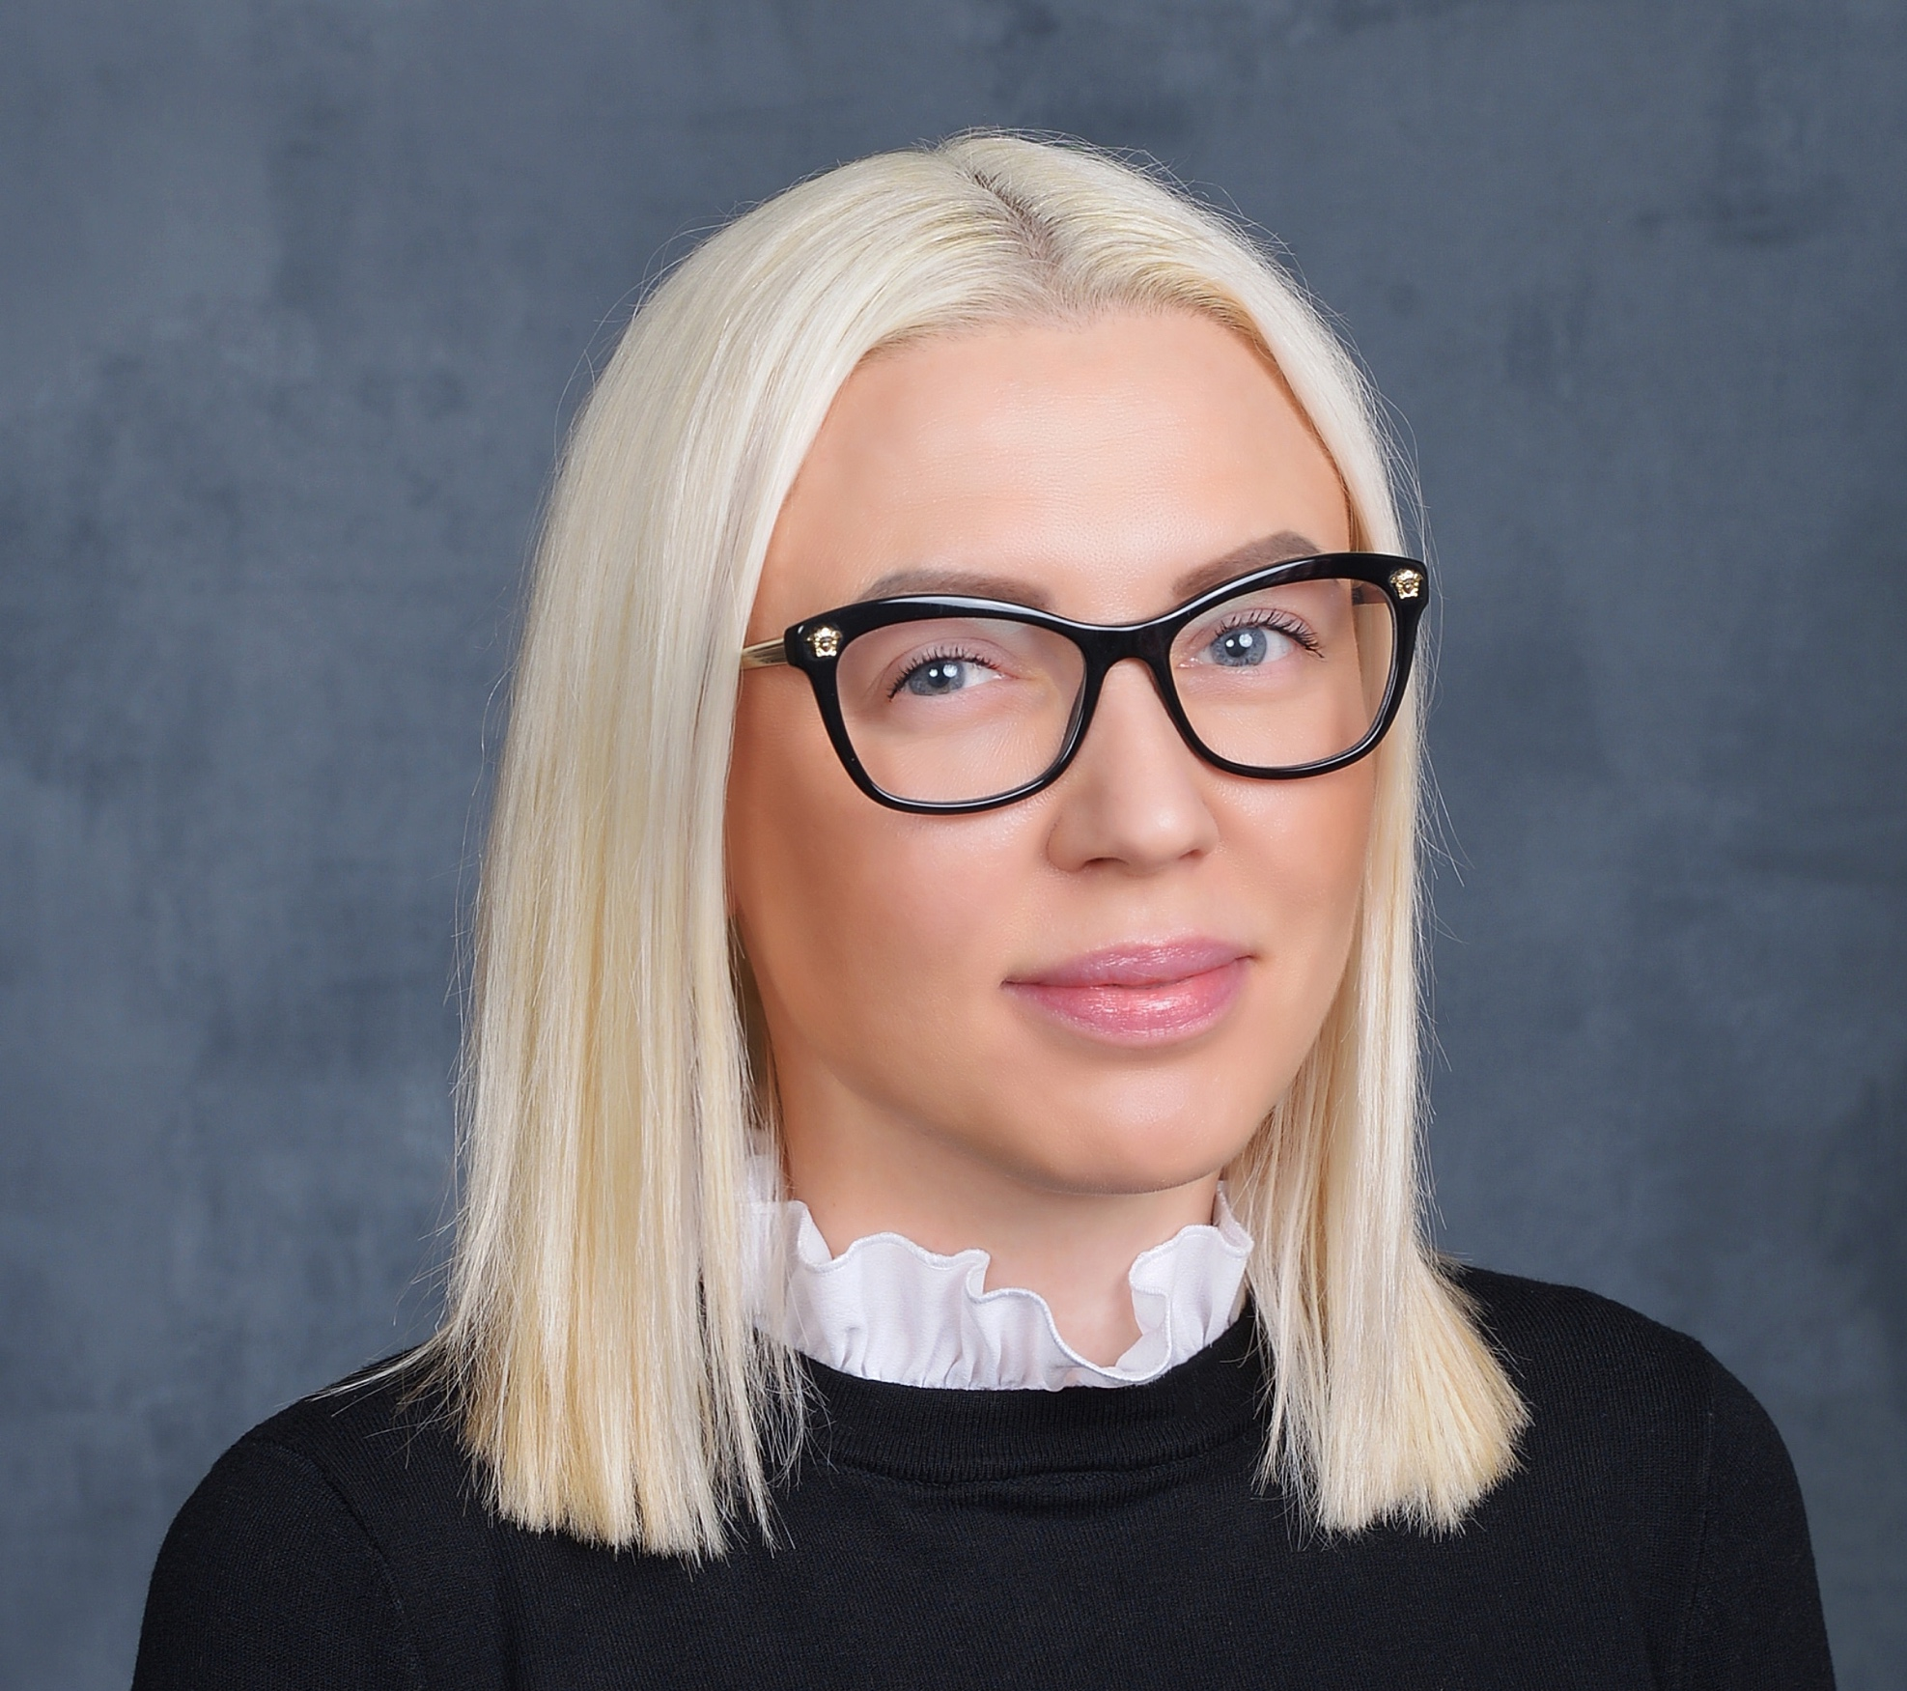


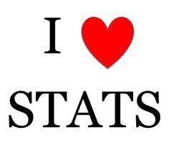


Volha Tryputsen: my statistics journey
B.A. Statistics/
Economics coursework
Discovery Statistics
R
Innovation
Data Science
Women
2010
2014
2021
1999
2007
2014
B.A., M.S. Biostatistics
Doctor of Public Health candidate, Biostatistics

Slide 11
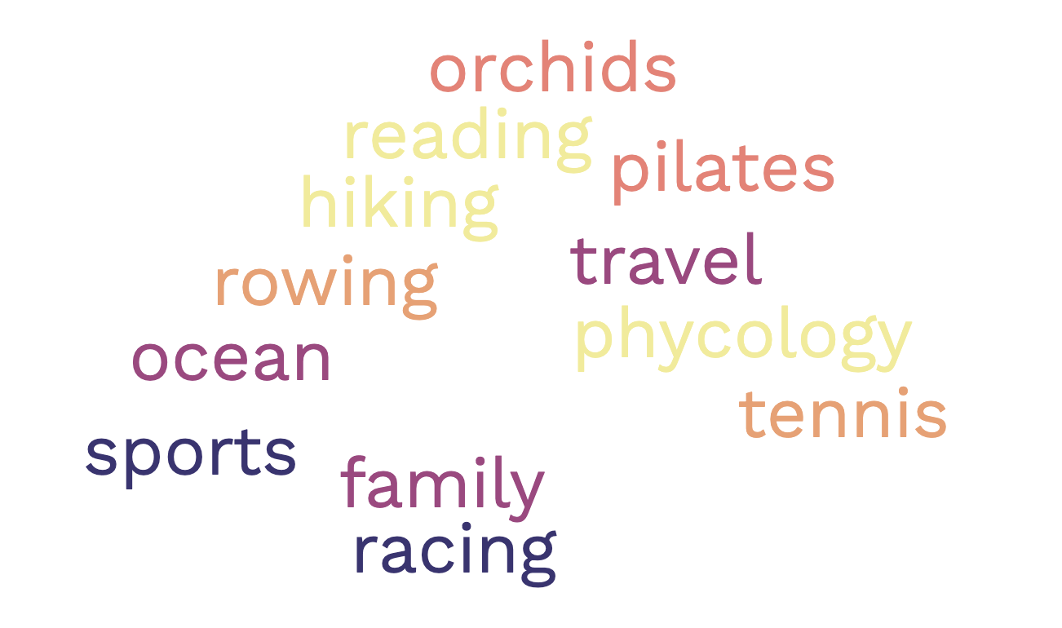
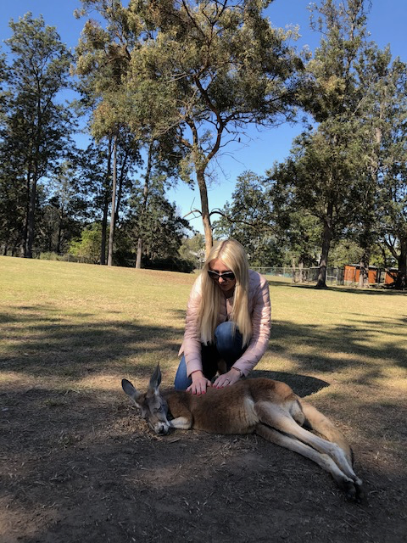



Volha Tryputsen: when I take my stats hat off…
volha-tryputsen
Volha Tryputsen
volha_tryputsen

Slide 12

How Much Statistics Do You Know?
Notes:
Class participation: classes taken, applied cases, statistical programming skills

Slide 13
Type this in your browser: pollev.com/istats820

Slide 14
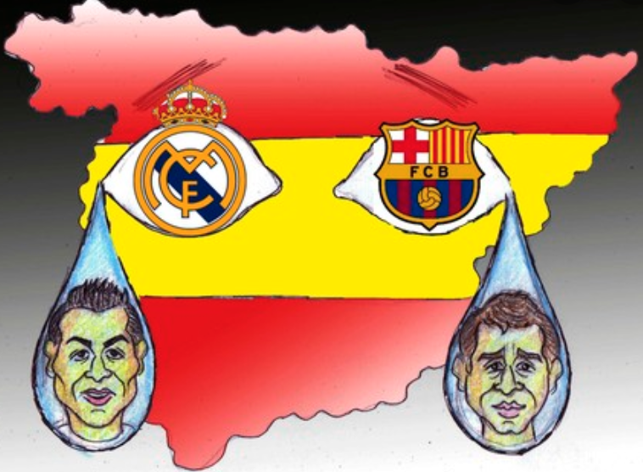
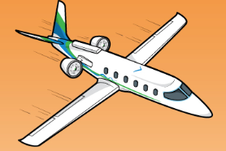

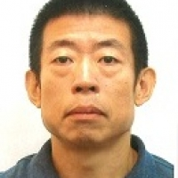
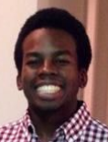
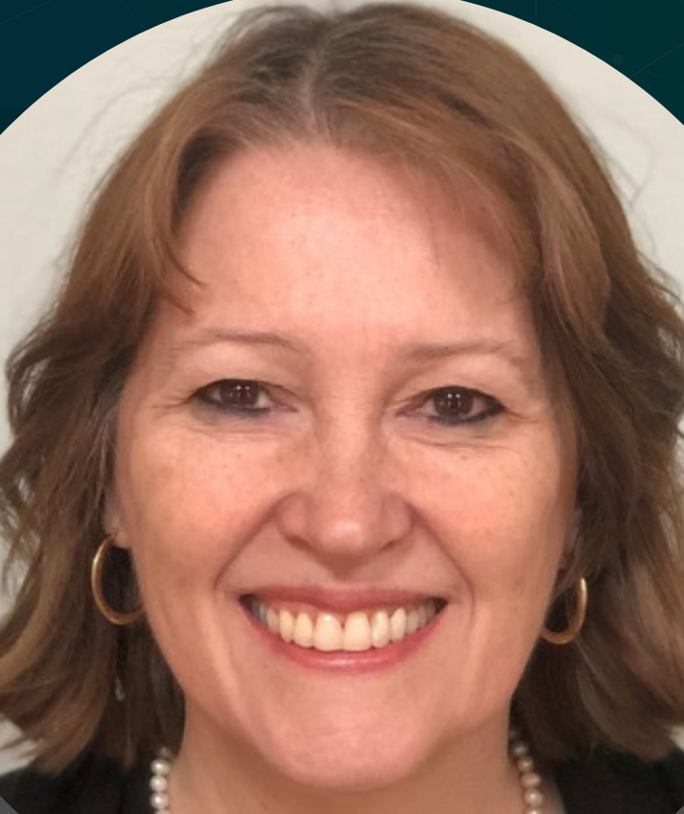
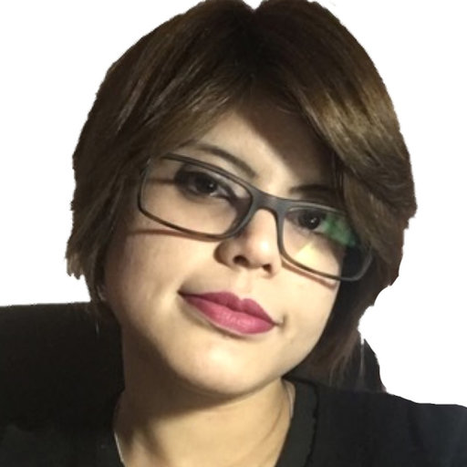
Prof. Javier Cabrera
RUTGERS
Current research interest
Statistical Genomics (big p & small n)
Quantile Normalization
Enriched Random Forest
Enriched Lasso
Cellular level Experiments (big p & very big n)
Data Nuggets
Statistics for cardiovascular medicine
2019-2020 (great year) PhD grads
Ben Li
(China)
Pfizer
Tray Beavers
J&J Research
(North Carolina)
Ellie Small
Drew University
(Holland)
Debopriya Ghosh
J&J Research
(India)

Slide 15

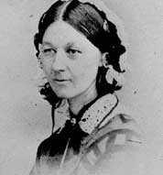
“To understand God's thoughts we must study statistics, for these are the measure of His purpose.”
“The best thing about being a statistician is that you get to play in everyone's backyard.”
John W Tukey
(1915-2000)
Florence Nightingale
(1820-1910)
Econometrics
Biostatistics In Science & Medicine
Psychometrics
AI / Machine Learning
Biometrics
Statistics
Big Data
Bioinformatics
Data Analytics
Data Mining
Data Sciences

Slide 16
Eminence Based Medicine
Data Science Biostatistics
Evidence Based Medicine
Bias Medicine??
Big Data Medicine

Slide 17
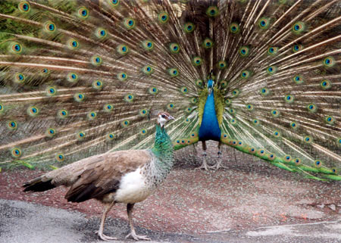
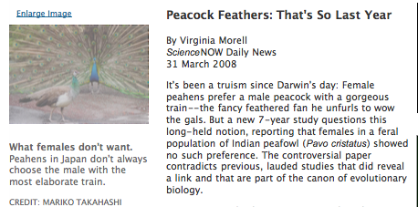
Peacock Female Choice
It’s not what you think – it is what you know

Slide 18
Cardiovascular diseases in Women
Woman vs. Men
Are they the same?
TARGET BLOOD PRESSURE IN WOMEN

Slide 19
Cardiovascular diseases in Women
Woman vs. Men
Are they the same?
TARGET BLOOD PRESSURE IN WOMEN
Question: What should be the target blood pressure for WOMEN with hypertension?

Slide 20
Cardiovascular diseases in Women
Woman vs. Men
Are they the same?
TARGET BLOOD PRESSURE IN WOMEN
Question: What should be the target blood pressure for WOMEN with hypertension?
Answer: 120 SAME AS MEN!

Slide 21
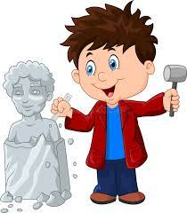
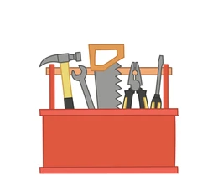
Know Your Tools
What are the research questions you are trying to answer?
What data do you need to answer them?
Can you design an experiment that will provide you with the data? Think about the experimental design long and hard!
What are the right tools, i.e., appropriate statistical techniques that can help you answer the questions?
Do you understand the statistical methods well enough to be confident with your inference? Things to consider:
Distributions
Missing data
Outliers

Slide 22
Now, Let's Learn Some Statistics! (over the next 3 sessions)

